Slide 1
Canteen Management System (CanteenMate)
Prepared by Dibisha Haleyo Joshi

Slide 2
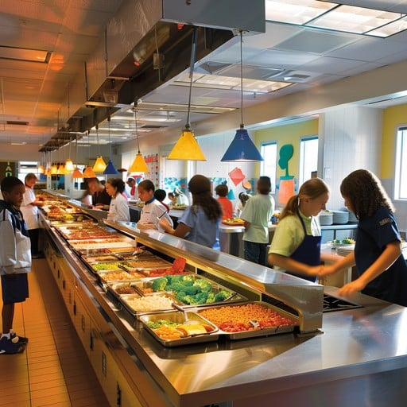
Introduction
Canteens provide daily meals in institutions, offices, and public spaces.
Manual operations cause issues like slow service, inventory errors, and lack of financial transparency.
CanteenMate is a digital canteen management system (CMS) to streamline operations.
Features include real-time ordering, and cashless payments.
Enhances customer experience by reducing wait times and order errors.
Helps to improve service quality, and boost productivity.

Slide 3
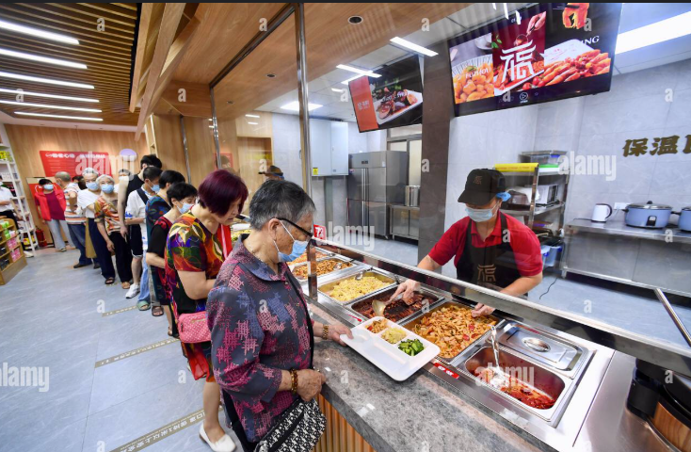
PROBLEM STATEMENT
Key Challenges in Canteens
Long Waiting Times: Manual processing leads to delays and overcrowding.
Order Inaccuracies: Paper-based orders often result in incorrect or lost items.
Inefficient Payment Handling: Cash transactions are slow, error-prone, and susceptible to theft.
Lack of Data Analytics: No insights into customer preferences or sales trends.
No Pre-ordering Facility: Customers can't order ahead; this increases congestion and disrupts kitchen planning.
Limited Transparency and Communication: Customers aren’t updated about order status, causing confusion and repeated follow-ups.

Slide 4
OBJECTIVES
Optimize the ordering and payment process and enhance customer engagement with a feedback system.
Improve efficiency and accuracy of canteen operations.
CanteenMate aims to create a fast, seamless, and engaging experience. It focuses on enhancing customer satisfaction and operational efficiency.

Slide 5
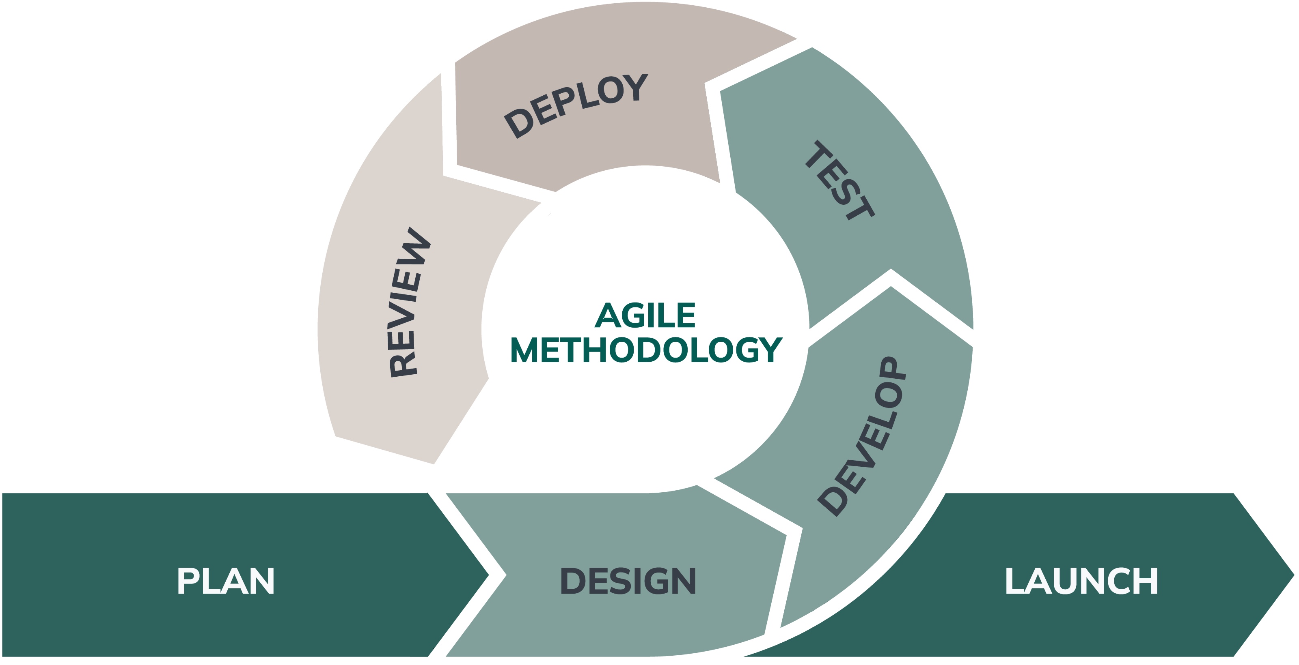
METHODOLOGY
I am using Agile methodology. This allows for flexibility, collaboration, and continuous feedback.
Why Agile?
Adapts to changing requirements quickly.
Continuous feedback ensures product meets needs.
Risks are addressed early through iterations.
Improves communication and problem-solving.

Slide 6
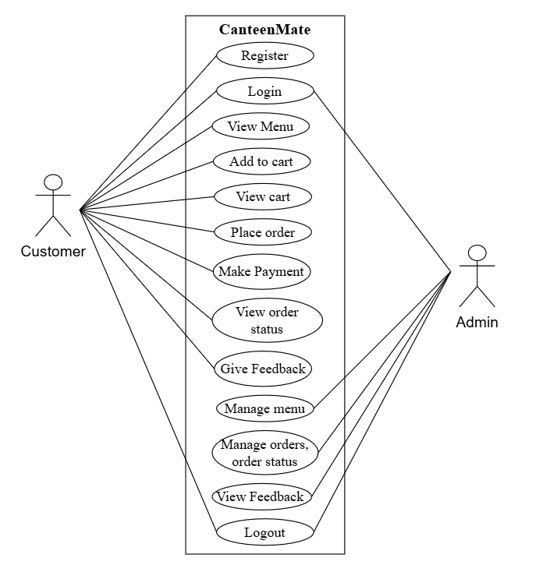
REQUIREMENTS ANALYSIS
Functional Requirements
Functional requirements for admin and customers are displayed in the beside use case diagram:

Slide 7
Non-Functional Requirements
These define how the CanteenMate system will perform and operate beyond its core functionalities.
Availability
Accessible 24/7 as a web-based application
Security
Authorized access only
No sharing of data with third parties
Performance
Optimized for smooth and responsive operation
Reliability
Provides consistent results for the same operations, regardless of the user

Slide 8
Implementation Tools
Implementation tools include both frontend and backend technologies
Frontend tools: HTML (Hypertext Markup Language), CSS (Cascading Style Sheet), JavaScript, Bootstrap, Jinja2 (Template engine)
Backend tool: Python, flask
Database tool: SQLite, SQLAlchemy
CASE (Computer-Aided Software Engineering) Tools: draw.io
These tools collectively enable developers to create a functional and visually appealing hotel reservation system effectively.

Slide 9
Collaborative Filtering: Personalized Food Recommendations
User-Based Filtering
Recommends items liked by similar users.
Similarity calculated using cosine similarity.
Item-Based Filtering
Recommends items similar to what the user already likes.
CanteenMate uses collaborative filtering algorithms. This suggests dishes based on user preferences. It analyzes past interactions to provide personalized recommendations.

Slide 10
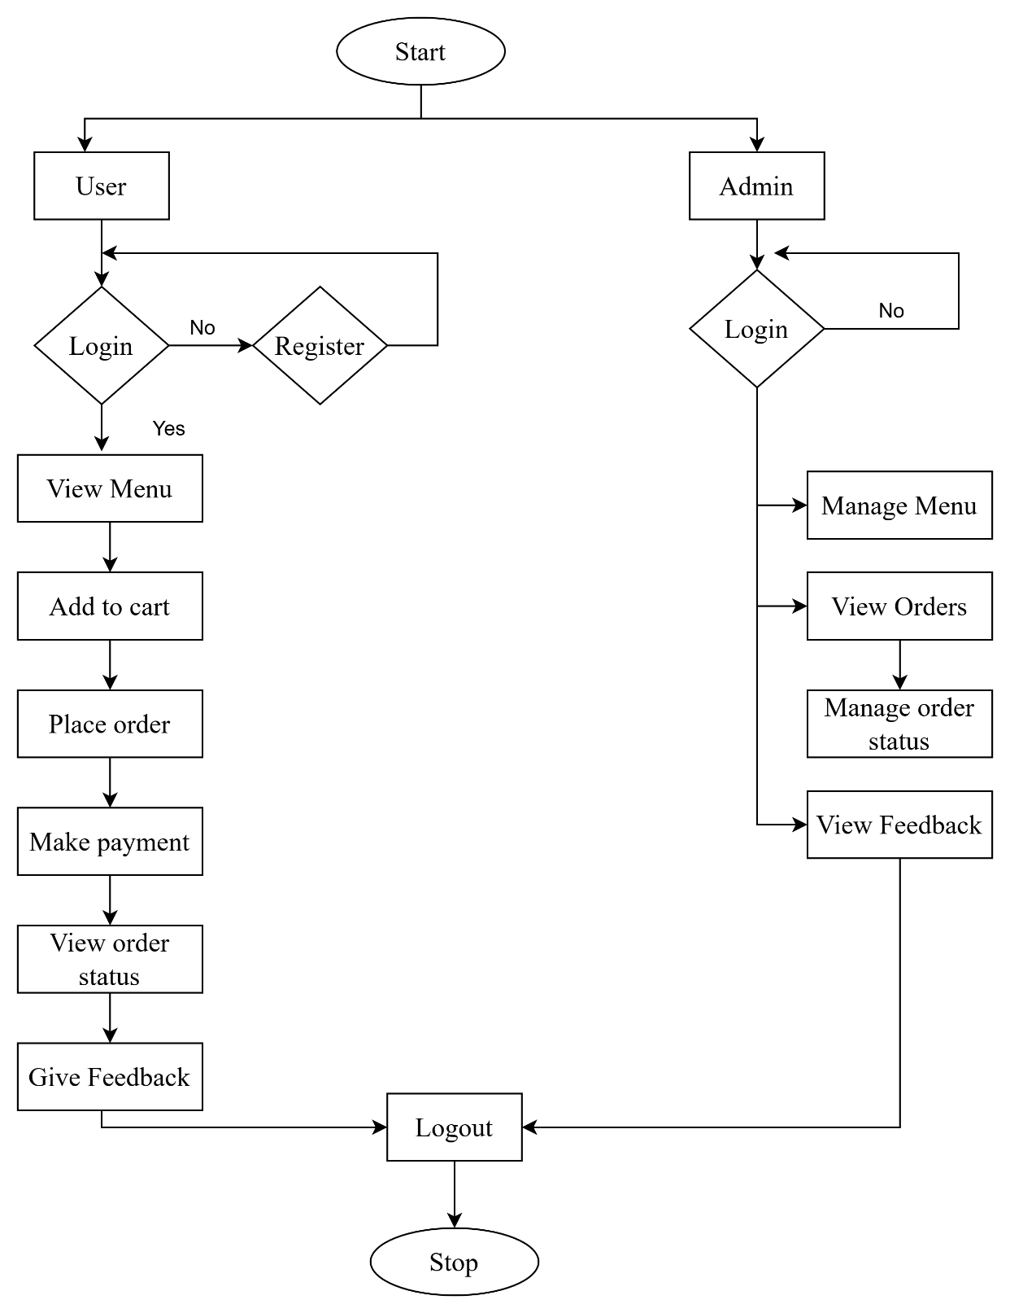
Flowchart
🔹 Start → Select User or Admin
👤 User Flow
• Register / Login
• View Menu
• Add to Cart
• Place Order
• Make Payment
• View Order Status
• Give Feedback
Yes
👨‍💼 Admin Flow
• Login
• Manage Menu
• View Orders
• Manage Order Status
• View Feedback
🔹 Logout → Stop

Slide 11
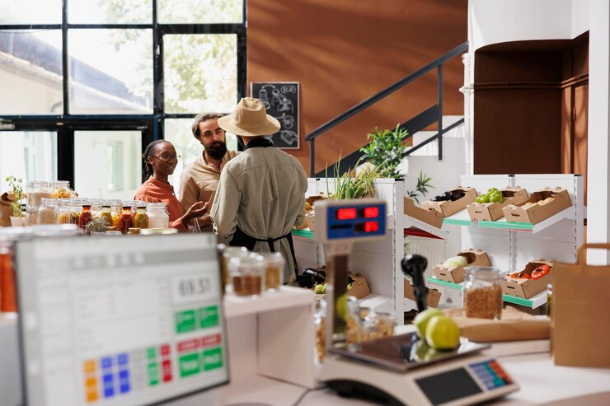
EXPECTED OUTCOME
CanteenMate aims to deliver a range of outcomes. This enhances efficiency, accuracy, and overall user experience. The system automates core processes. Customers will receive real-time updates. We expect it to modernize the entire canteen ecosystem.

Slide 12
CONCLUSION
CanteenMate improves canteen operations through automation and digitalization.
Enhances speed, accuracy, and customer satisfaction.
Built using reliable, cost-effective tools and technologies.
Agile methodology ensures flexibility and continuous improvement.
Offers a modern, user-friendly solution for efficient canteen management.

Slide 13
Thank you

